Slide 1
Shaik Khajavali
MCA(MBA)
1302-20-862-086

Slide 2
THANKS TO OUR MENTOR

Slide 3
Data Mining and Feature Analysis Of
College Student’s Campus Network Behaviour

Slide 4
The Problem

Slide 5
Existing System
In the existing system we analyse student behaviour based on campus activities in classroom, laboratories etc.., by mentors.
Practically making it not possible to concentrate on each student and missing the opportunity of early intervention.
Which results in the following disadvantages
Decreased interest and concentration in students.
Selection of less suitable learning methods for students.
Decrease in students score in exams over time.
Developing physiological problems in students and etc…

Slide 6
The Solution
Is
Early intervention

Slide 7
Solution
Increasing Staff
Using ML

Slide 8
Solution
Increasing Staff
Using ML

Slide 9

Power of Machine Learning
ML is utilized in every sector
-Medical sector
-Engineering field
-Agriculture
-Security etc…

Slide 10
Web Server
Web Browser
Student Data
Category 1
Grade
Category 2
Previous avg
ML MODEL
Hand raise count in class
etc…
Category n

Slide 11
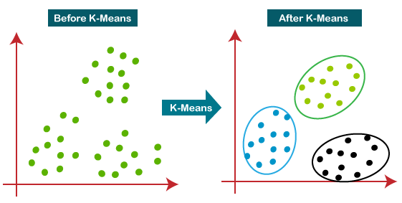
The Model

Slide 12
Main Modules
Index
Admin
LoginAction
AdminHome

Slide 13
System Requirements
Operating System : Windows/Mac/Linux
Client side : HTML, Css, JavaScript
Language : JAVA
Database : MySql
Server : Tomcat
Ram : 1GB
Hard Disk : 10Gb

Slide 14
Future and Feasibility ?

Slide 15

THANK
You
Any
Questions
?
Link : https://github.com/issei511/issei511-student_data_analysis

